Slide 1
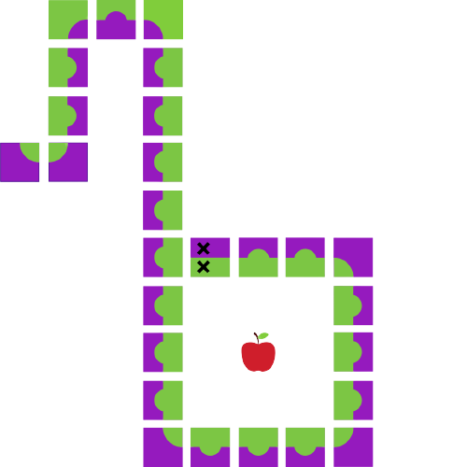
Java Workshop 2
Aadila Ali Sabry

Slide 2
Why Code?

Slide 3
Variables

Slide 4
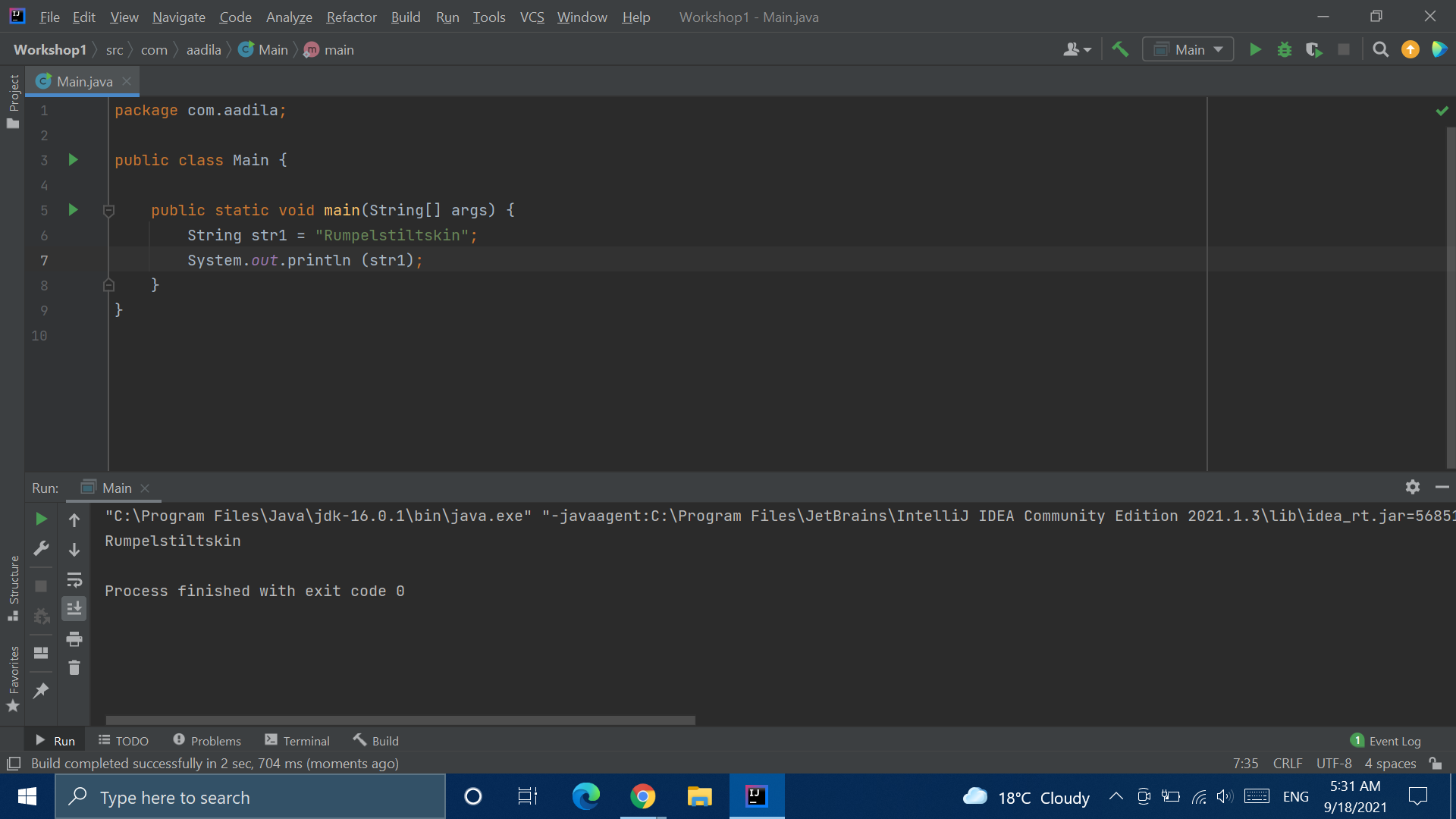
Variables

Slide 5
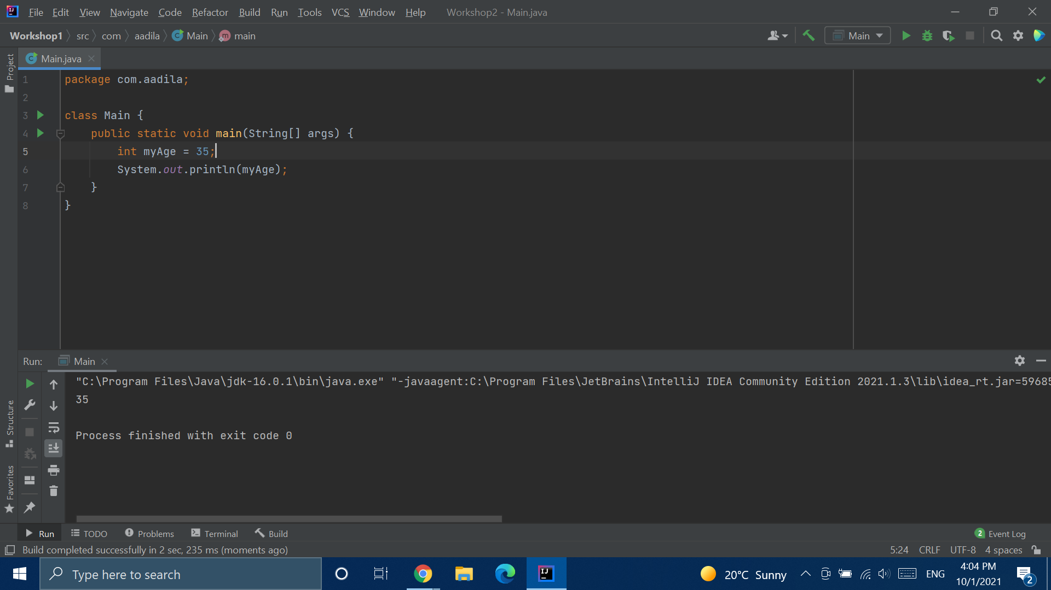
Variables

Slide 6
Data Types
Data Type | Holds
int | Whole Numbers
double | Numbers with decimal places
char | Single characters
boolean | One of true or false
String | “Strings” of characters

Slide 7
11000001

Slide 8
Why Do We Have Data Types?
This is the character ‘a’ in binary:
1100001
This is the number 97 in binary:
1100001
...Why?

Slide 9
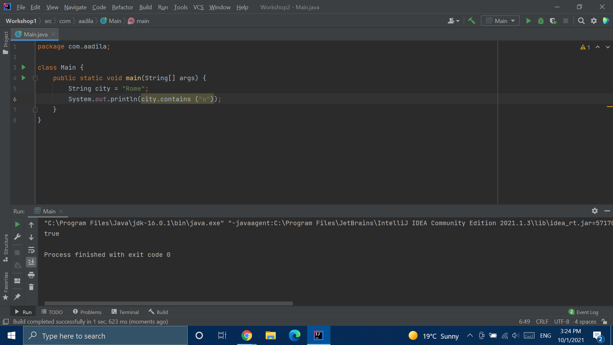
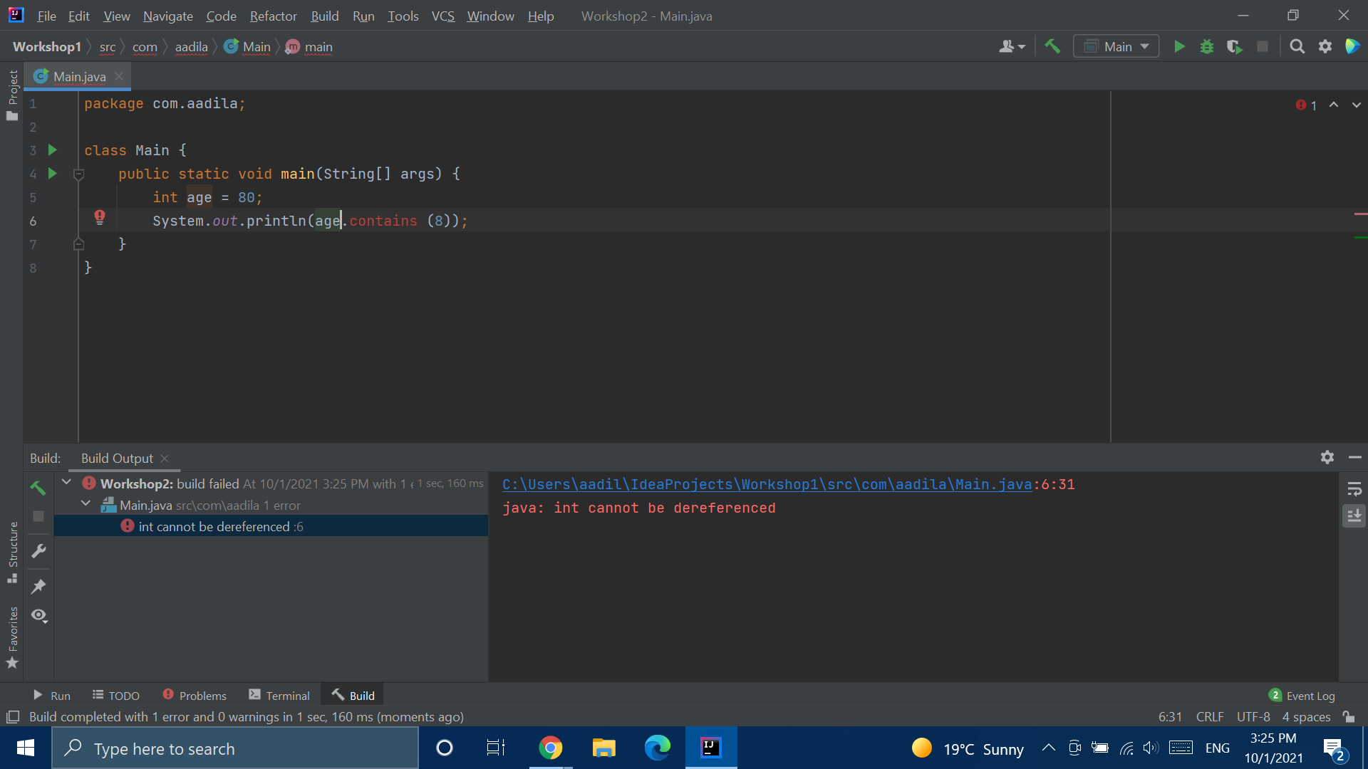

Slide 10
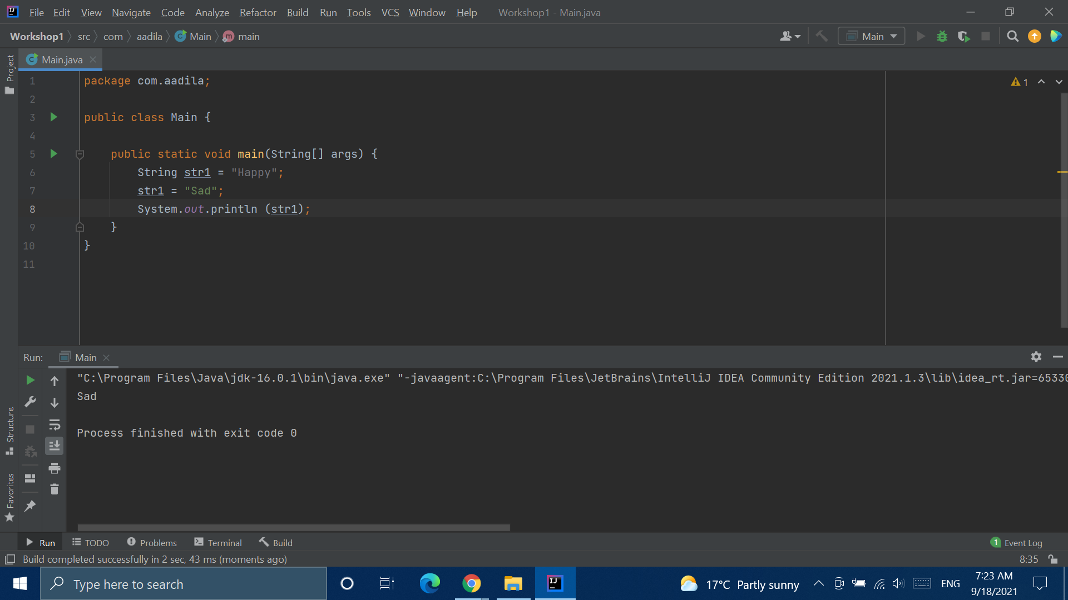
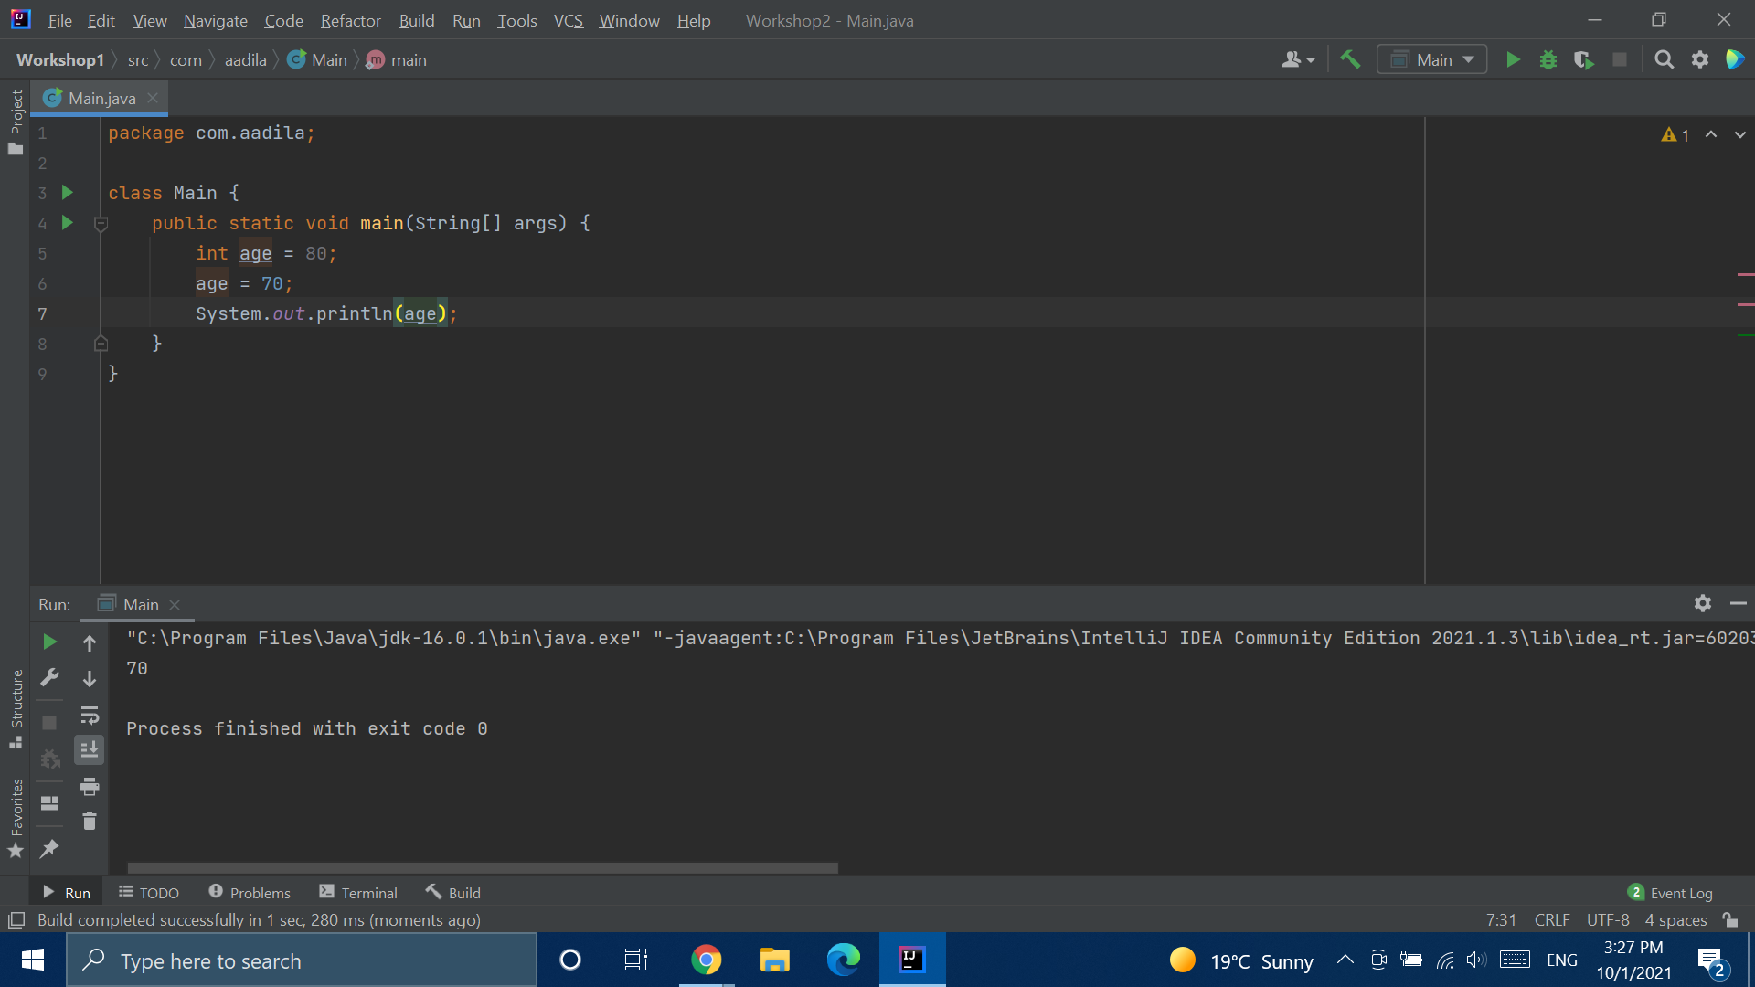

Slide 11
Variable Declaration
And Initialization
Declaring variables: Telling java that they exist, and what data type they are.
Initializing them: giving them their (initial) values

Slide 12
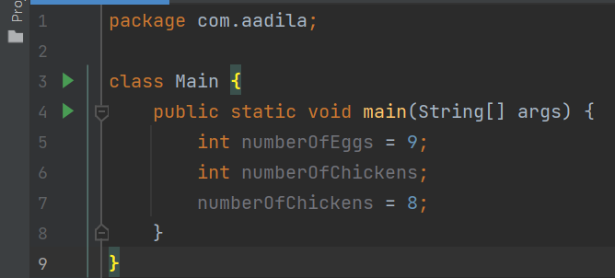
<Type> <Variable Name> = <Value>;
<Type> <Variable Name>;
<Variable Name> = <Value>;

Slide 13
=

Slide 14
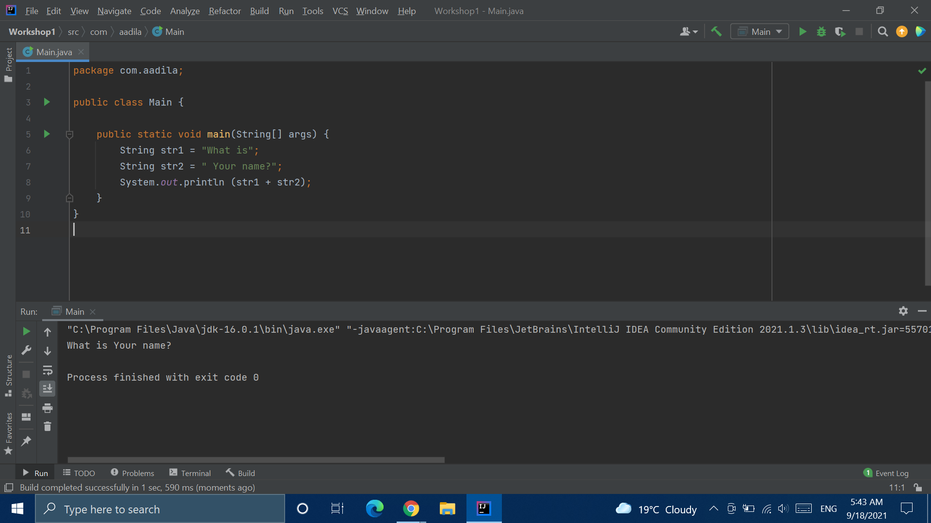
Notes:
https://replit.com/@AadilaAliSabry/Addition#Main.java

Slide 15
Break
Notes:
https://replit.com/@AadilaAliSabry/double#Main.java
Okay, activity again.
Who knows why the last one produces an error? You need to have a number on at least one side of the decimal point for java to recognize it as a decimal number. You can omit numbers on one side, but not both.
Now, for priceApples. Why didn’t I just make it an int? Maybe I’m in a store where price drops by 30 cents every day if the apples don’t sell. Maybe tomorrow the price will be 34.70. Then I’ll have a double value, but my variable will still be int if I didn’t think ahead and make it a double type variable.

Slide 16
double
Notes:
https://replit.com/@AadilaAliSabry/double#Main.java

Slide 17
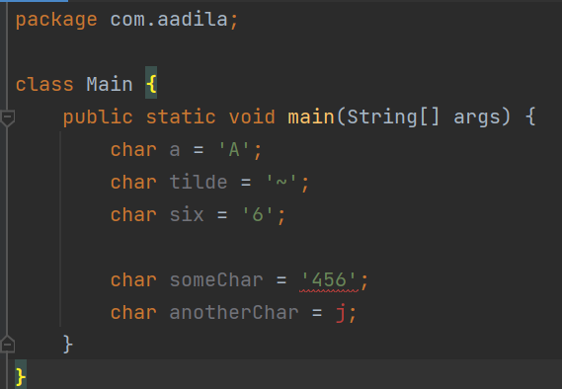

Slide 18
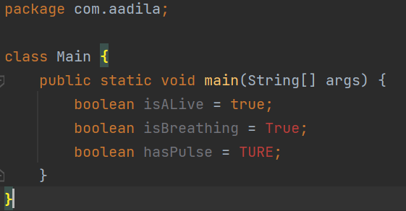

Slide 19
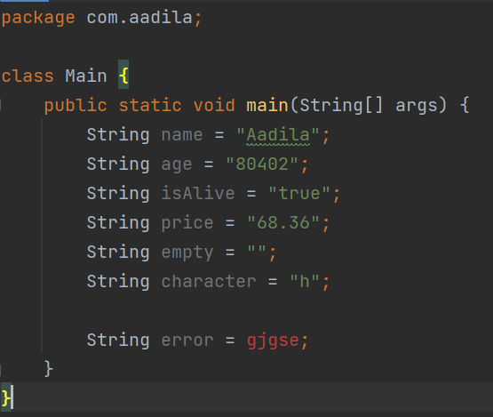

Slide 20
Data Types
Data Type | Example | Usage
int | int someNumber = 56; | Whole Numbers, ie. INTEGERS
double | double someDecimal = 45.25; double someOtherDecimal = .46; double anotherDecimal = 23. ; NOT: double someDecimal = . ; | Numbers w/ decimal places You can omit numbers before or after the decimal point, but NOT both
char | char someCharacter = ‘h’; char someOtherCharacter = ‘5’; char anotherCharacter = ‘~’; NOT: Char oneMoreCharacter = ‘rjjb’; | Used for single characters These characters can be single-digit numbers, letters, or special characters NOTE: put them in single quotes! NOTE: only ONE character!

Slide 21
Data Types
Data Type | Example | Usage
boolean | boolean someBoolean = true; boolean someBoolean = false; NOT: boolean someBoolean = True; boolean someBoolean = FALSE; | Can hold one of two values: true or false NOTE: true and false are in lowercase
String | String someString = “true”; String someOtherString = “469.35”; String thirdString = “” ; String anotherString = “g”; | Can hold ANYTHING, as long as its in quotes

Slide 22
Naming Variables
Notes:
https://replit.com/@AadilaAliSabry/Naming-Variables

Slide 23
Naming Variables
Names:
Can contain letters, digits, underscores, and dollar signs
Must begin with a letter
Cannot contain whitespace
Can also begin with $ and _
Names are case sensitive
Cannot be keywords

Slide 24
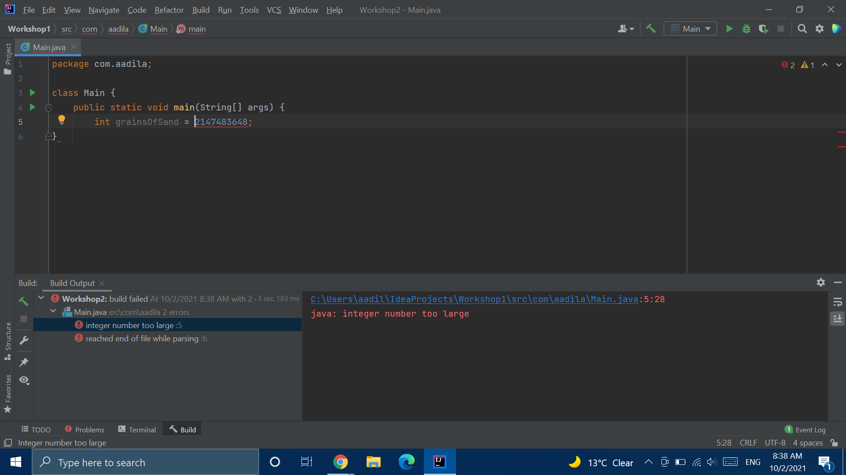

Slide 25
Different Sizes of Variables
long: long can hold values MUCH larger than ints
long grainsofSand = 9_223_372_036_854_775_807 L ;
long debtInPennies = - 9_223_372_036_854_775_808 l ;
short: for values smaller than ints.
short numberOfParticipants = 32_767;
short depthOfOcean = - 32_768 ;
byte: for values smaller even than shorts.
byte ageOfTortoise = 127;
byte depthOfPond = - 128;

Slide 26
Different Sizes of Variables
float: holds values smaller than double (with less precision)
float priceApples = 597.63 F ;
float debtInPennies = - 596.29 f ;

Slide 27
“” ‘’

Slide 28
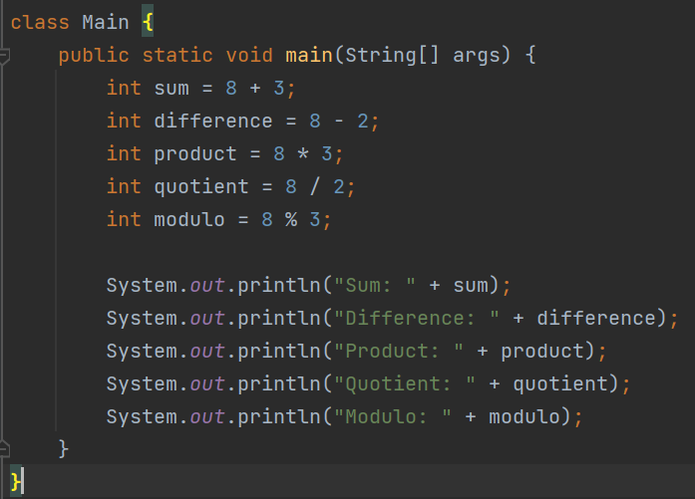
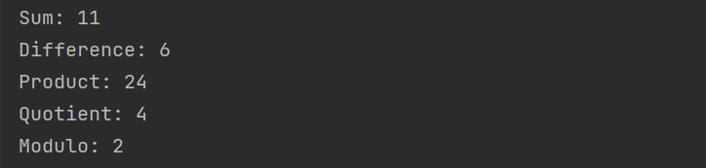
Notes:
https://replit.com/@AadilaAliSabry/Mathematical-Operators#Main.java

Slide 29
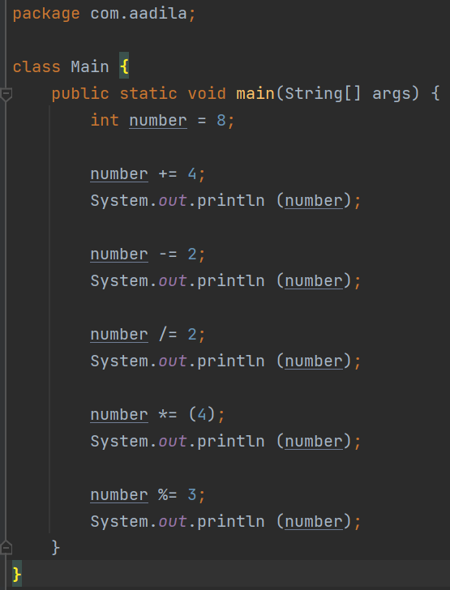


Slide 30
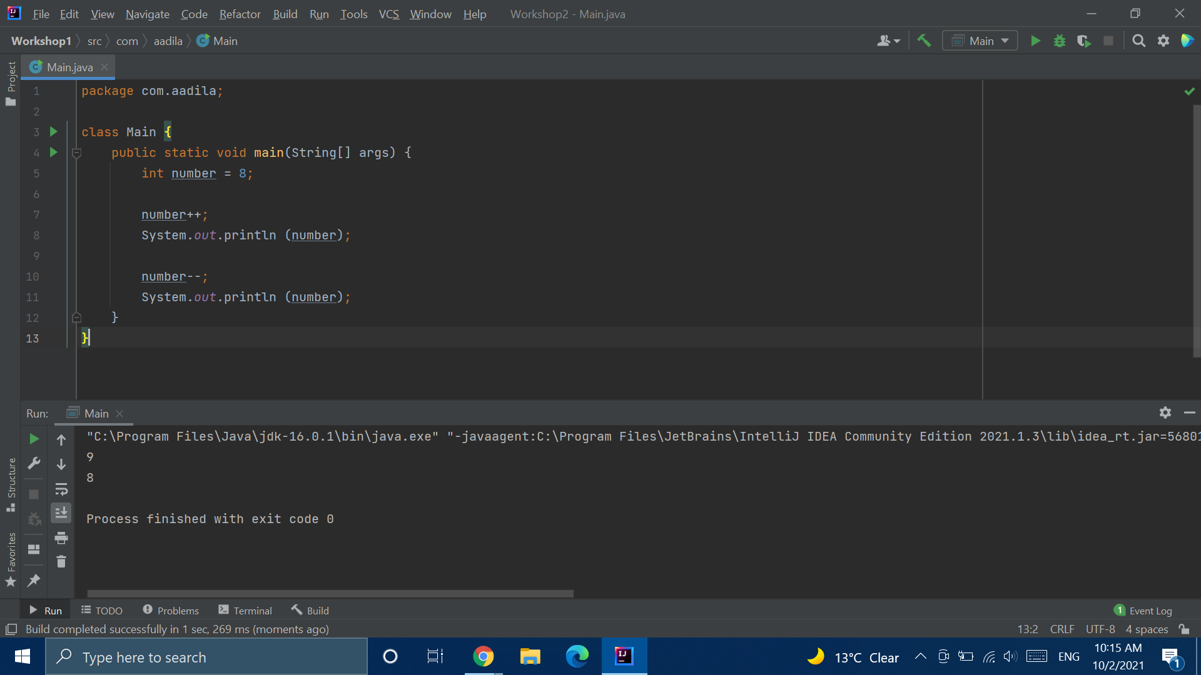

Slide 31
Average
Notes:
https://replit.com/@AadilaAliSabry/Average-2

Slide 32
Sum of Digits
Notes:
https://replit.com/@AadilaAliSabry/Sum-of-Digits

Slide 33
Intellij + Exercises

